Slide 1


Liam Stuart
30/09/2024

Slide 2

Outline
Executive Summary
Introduction
Methodology
Results
Conclusion
Appendix

Slide 3
Executive Summary
The methodologies used to analyze the data included:
Data Collection using the SpaceX REST API and Web Scraping;
Exploratory Data Analysis (EDA) using SQL and Data Visualisation;
Visual Analytics using Folium and Dash;
Machine Learning Prediction.
Summary of results:
EDA Results.
Data Visualisation and Interactive Analytics Results.
Predictive Analysis Using Machine Learning.

Slide 4
Introduction
We are assuming the role of a data scientist working for SpaceY, a competitor against SpaceX, and are being asked to predict the price for the launch of a rocket. SpaceX are able to keep costs lower than competitors by reusing the first stage of their launch if the first stage lands.
The main goal for the project is to predict whether or not the first stage of a Falcon 9 SpaceX rocket will land successfully given prior information about it, such as its Booster Version or Launch Site.

Slide 5

Section 1

Slide 6
Methodology
Executive Summary
Data collection methodology:
Data was collected via the following means:
The SpaceX REST API (https://api.spacexdata.com/v4/rockets/)
Web Scraping from Wikipedia (https://en.wikipedia.org/wiki/List_of_Falcon_9_and_Falcon_Heavy_launches)
Perform data wrangling
The data was then preprocessed to prepare it for the Machine Learning phase. This included cleaning null values, removing irrelevant columns, and creating a new outcome label based on outcome data.

Slide 7
Methodology
Executive Summary
Perform exploratory data analysis (EDA) using visualization and SQL.
Perform interactive visual analytics using Folium and Plotly Dash.
Perform predictive analysis using classification models:
The data was normalised and then split into training and test sets. Logistic Regression, SVC, Decision Tree, and KNN models were all trained across various parameters and their accuracies evaluated on the test set.

Slide 8
Data Collection
The two main data collection methods utilized the SpaceX REST API and Web Scraping from Wikipedia.
The SpaceX API returns the data as a JSON file, which can then be converted into a csv file for further processing.
The BeautifulSoup package was used for web scraping, where the html data was extracted and then converted to a csv file.
Response from SpaceX API
Response from SpaceX API
HTML Response from Wikipedia
Returns data in JSON file
Parse data using Beautiful Soup
Convert to csv file
Convert to csv file

Slide 9
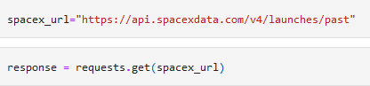
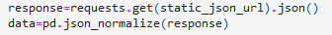
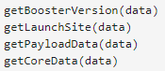
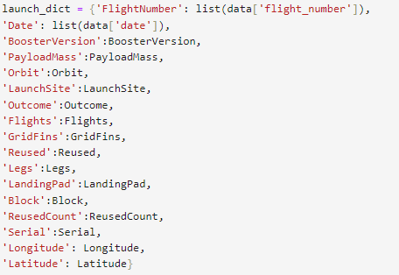
Data Collection – SpaceX API
1. Response from API
Data collection using the SpaceX REST API calls.
Code: (https://github.com/liam-stuart/Applied-Data-Science-Capstone/blob/main/Data%20Collection%20API.ipynb)
2. Convert to JSON File, then Pandas DataFrame
3. Apply functions to extract information
4. Create new Pandas DataFrame
5. Filter to Falcon 9 launches then convert to a csv file

Slide 10
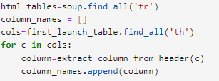
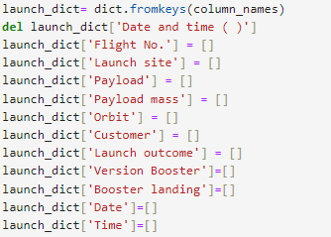
Data Collection - Scraping
1. Response from HTML, Creation of BeautifulSoup Object
Data collection using web scraping from Wikipedia.
Code: (https://github.com/liam-stuart/Applied-Data-Science-Capstone/blob/main/Web%20Scraping.ipynb)
2. Finding tables and extracting column names
3. Convert to Pandas DataFrame, append data (see code for further details)
4. Convert to csv file

Slide 11
Data Wrangling
Check for null values, calculate number of launches per site
Flowchart of the data processing stage, including some initial EDA
Code: (https://github.com/liam-stuart/Applied-Data-Science-Capstone/blob/main/Data%20Wrangling.ipynb)
Calculate the frequency of each orbit and their associated launch outcomes
Create a new landing outcome label using the Outcome column

Slide 12
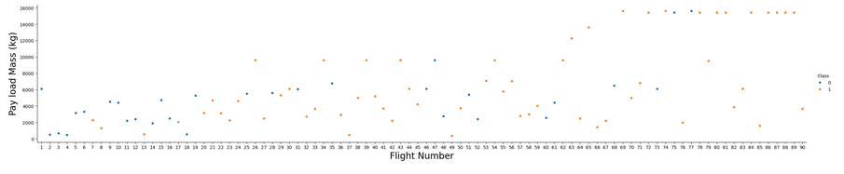
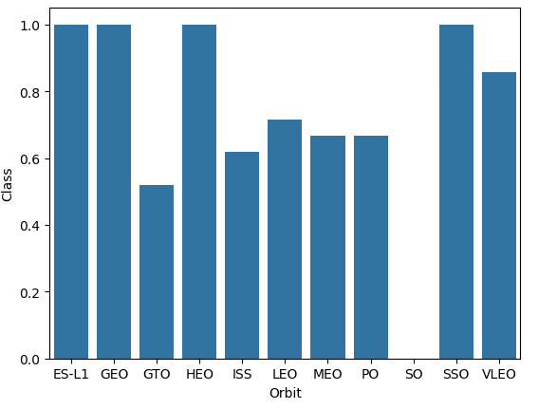
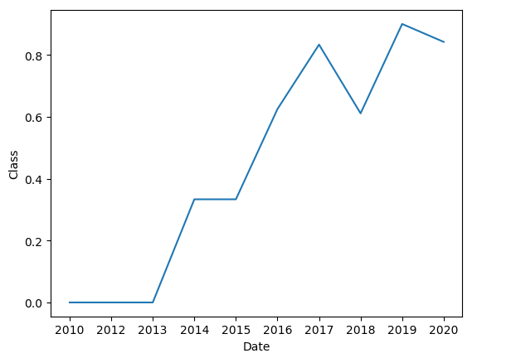
EDA with Data Visualization
To get a better grasp on the relationships between certain variables, charts were generated to visualize the data. Some are displayed below:
One immediate conclusion is that over time, the overall success rate of launches showed an increasing trend.
Code: (https://github.com/liam-stuart/Applied-Data-Science-Capstone/blob/main/Data%20Visualisation.ipynb)

Slide 13
EDA with SQL
The SQL queries performed displayed the following:
Unique launch site names;
5 records where launch sites began with ‘CCA’;
The total payload mass carried by NASA (CRS) boosters;
The average payload mass carried by booster version F9 v1.1;
The date when the first successful landing outcome in ground pad was achieved;
The names of the boosters which have success in drone ship and payload mass between 4000kg and 6000kg;
The total number of successful and failure mission outcomes;
The names of booster versions which have carried the maximum payload mass;
The records which will display the month names, failure landing outcomes in drone ship, booster versions, and launch site for the months in the year 2015;
Ranking the count of landing outcomes between the date 2010-06-04 and 2017-03-20 in descending order.
Code: (https://github.com/liam-stuart/Applied-Data-Science-Capstone/blob/main/SQL.ipynb)

Slide 14
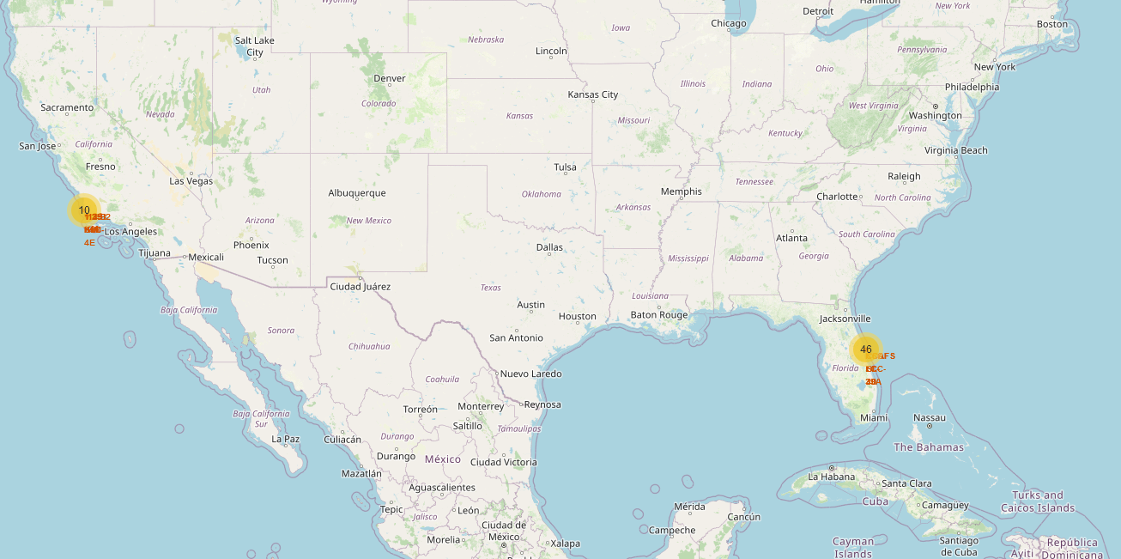
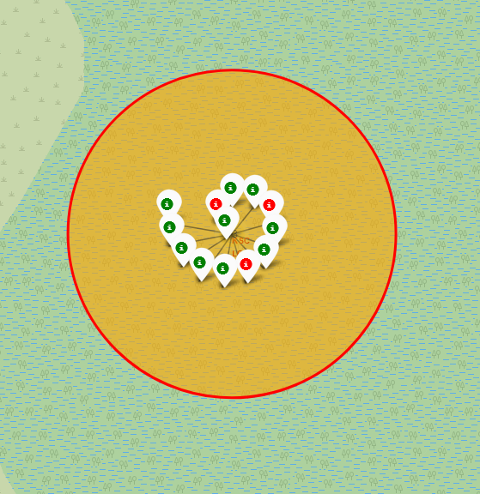
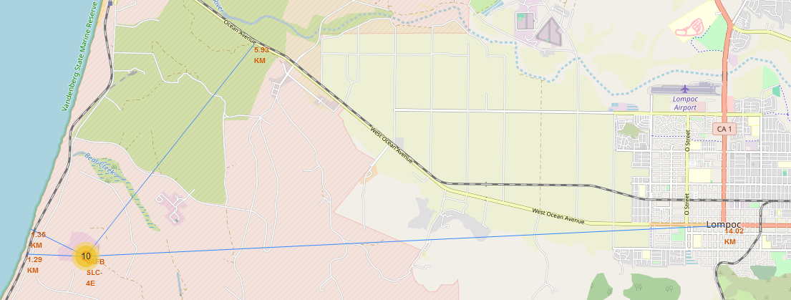
Build an Interactive Map with Folium
Map features have been created to identify the optimal launch site location, such as proximity to certain features and success rate for each site.
Code: (https://nbviewer.org/github/liam-stuart/Applied-Data-Science-Capstone/blob/main/Launch%20Site%20Maps.ipynb)

Slide 15
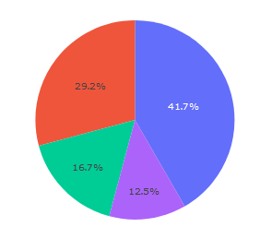
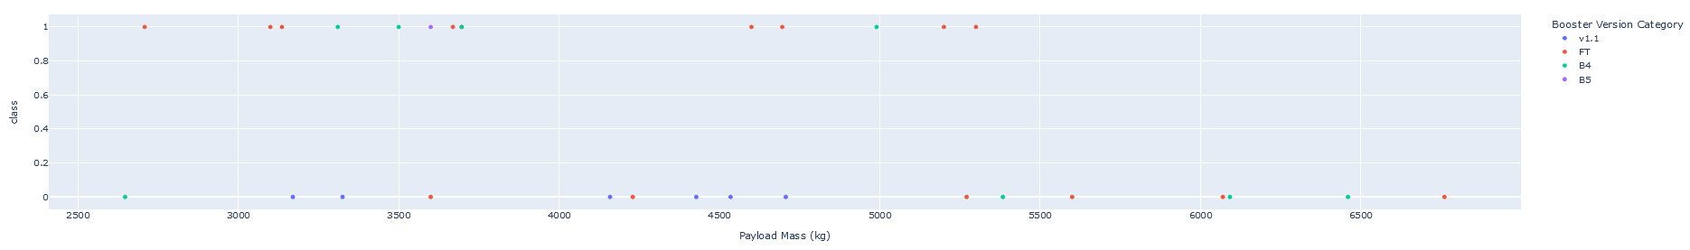
Build a Dashboard with Plotly Dash
An interactive dashboard has been created using Plotly Dash to easily compare Launch Site success rates, and how Payload Mass affects this.
Code: (https://github.com/liam-stuart/Applied-Data-Science-Capstone/blob/main/spacex_dash_app.py)

Slide 16
Predictive Analysis (Classification)
After the data was analyzed, machine learning was then utilized to train models on the data.
Code: (https://github.com/liam-stuart/Applied-Data-Science-Capstone/blob/main/Machine%20Learning%20Prediction.ipynb)
Normalize then split the data into training and test sets
Use GridSearchCV to optimize each model over various hyperparameters
Compare performance on training and test sets

Slide 17
Results
The Decision Tree model ended up performing best on both the training and test sets.
Success rates for SpaceX launches increased over time, likely due to more experience garnered from each launch and learning from mistakes.
Good launch site locations were coastal and near railways for easy access to rocket components, and far away from civilian infrastructure like cities and highways to minimize risk from failed launches.
Overall, KSC LC-39A had the highest success rate for launches.

Slide 18

Section 2

Slide 19
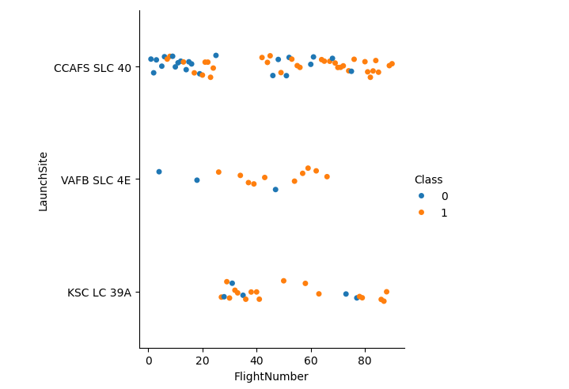
Flight Number vs. Launch Site
We can see that as flight number increases, the frequency of successful launches also increases. This trend holds for all sites.

Slide 20
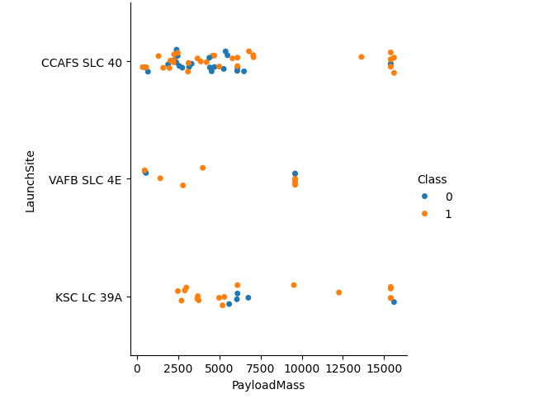
Payload vs. Launch Site
There does not appear to be a clear relationship between success rate and payload mass. Most of the failures on low masses are localised to CCAFS SLC 40.

Slide 21
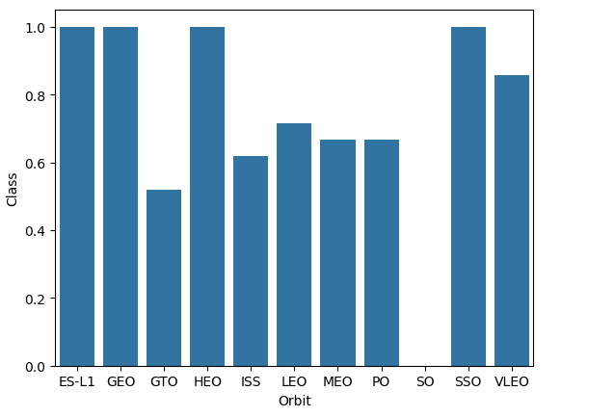
Success Rate vs. Orbit Type
ES-L1, GEO, HEO and SSO appear to have the highest success rates in terms of orbit, but it should be noted that some of these orbits only appear once or twice in the dataset, skewing their percentages.

Slide 22
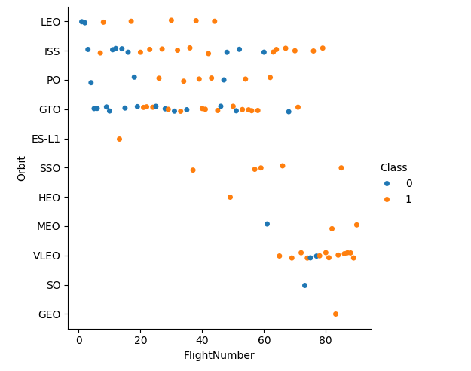
Flight Number vs. Orbit Type
The graph shows a clear shift towards higher orbit launches as the flight number increases.

Slide 23
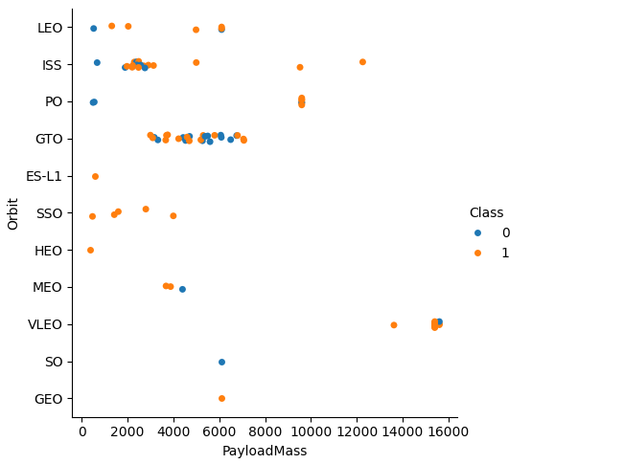
Payload vs. Orbit Type
The graph shows that ISS orbits in the 2000-4000kg range and GTO orbits in the 2000-8000kg range are by far the most common types of launches.

Slide 24
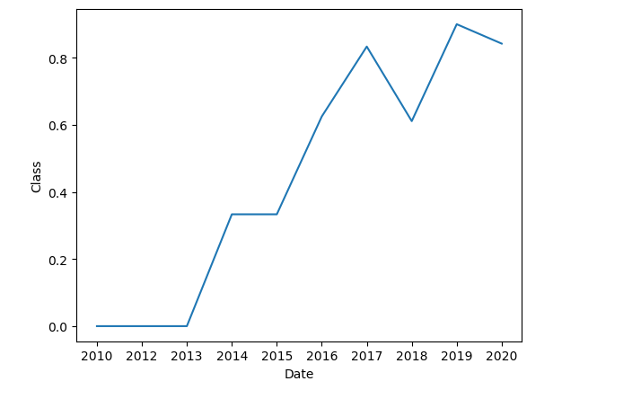
Launch Success Yearly Trend
The overall success rate shows a clear upward trend over the years since 2013.

Slide 25
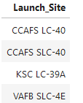
All Launch Site Names
%sql SELECT "Launch_Site" FROM SPACEXTABLE GROUP BY "Launch_Site"
A list of all of the unique launch site names.

Slide 26
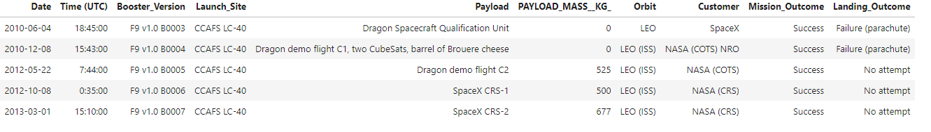
Launch Site Names Begin with 'CCA'
%sql SELECT * FROM SPACEXTABLE WHERE Launch_Site LIKE 'CCA%' LIMIT 5
A list of 5 different records where the launch site starts with ‘CCA’.

Slide 27
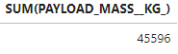
Total Payload Mass
%sql SELECT SUM(PAYLOAD_MASS__KG_) FROM SPACEXTABLE WHERE "Customer"=="NASA (CRS)“
The total payload mass carried by boosters launched by NASA (CRS)

Slide 28
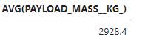
Average Payload Mass by F9 v1.1
%sql SELECT AVG(PAYLOAD_MASS__KG_) FROM SPACEXTABLE WHERE "Booster_Version"=="F9 v1.1"Present your query result with a short explanation here
The average payload mass carried by booster version F9 v1.1.

Slide 29
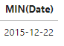
First Successful Ground Landing Date
%sql SELECT MIN(Date) FROM SPACEXTABLE WHERE "Landing_Outcome"=="Success (ground pad)“
The date of the first successful landing outcome in ground pad.

Slide 30
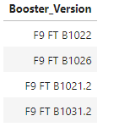
Successful Drone Ship Landing with Payload between 4000 and 6000
%sql SELECT Booster_Version FROM SPACEXTABLE WHERE ("Landing_Outcome"=="Success (drone ship)" AND 4000<"PAYLOAD_MASS__KG_" AND "PAYLOAD_MASS__KG_"<6000)
The names of boosters which have success in drone ship and have payload mass greater than 4000 but less than 6000.

Slide 31
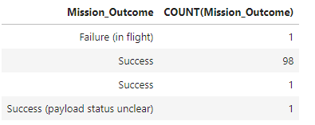
Total Number of Successful and Failure Mission Outcomes
%sql SELECT Mission_Outcome,COUNT(Mission_Outcome) FROM SPACEXTABLE GROUP BY Mission_Outcome
The total number of successful and failed mission outcomes.

Slide 32
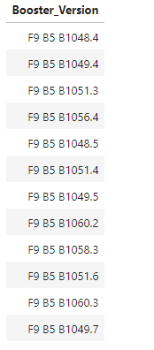
Boosters Carried Maximum Payload
%sql SELECT Booster_Version FROM SPACEXTABLE WHERE PAYLOAD_MASS__KG_ == (SELECT MAX(PAYLOAD_MASS__KG_) FROM SPACEXTABLE)
List of booster versions which have carried the maximum payload.

Slide 33
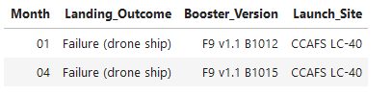
2015 Launch Records
%sql SELECT substr(Date,6,2) as Month,Landing_Outcome,Booster_Version,Launch_Site FROM SPACEXTABLE WHERE (substr(Date,0,5)=='2015' and Landing_Outcome=='Failure (drone ship)’)
List of records in year 2015 with landing outcome being a failure (drone ship).

Slide 34
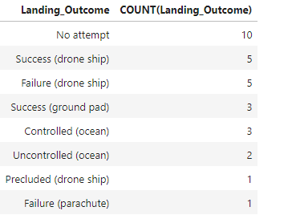
Rank Landing Outcomes Between 2010-06-04 and 2017-03-20
%sql SELECT Landing_Outcome,COUNT(Landing_Outcome) FROM SPACEXTABLE WHERE (Date>'2010-06-04' AND Date<'2017-03-20') GROUP BY Landing_Outcome ORDER BY COUNT(Landing_Outcome) DESC
Count of all landing outcomes in descending order.

Slide 35

Section 3

Slide 36
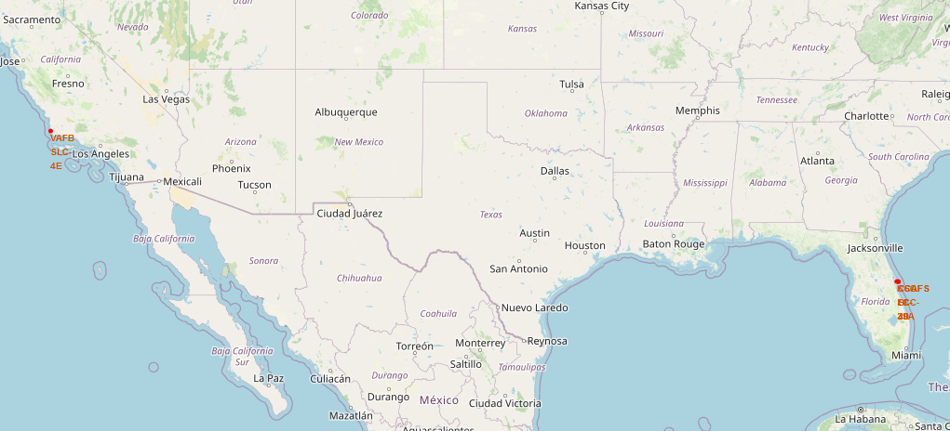
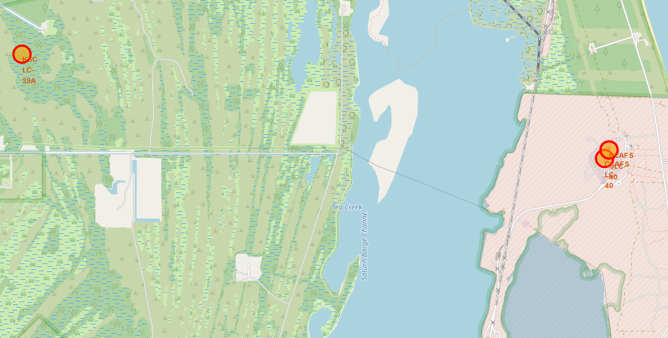
Location Markers for Each Launch Site
A map showing all location markers. Due to the close proximity of three of them, a zoom in of that region has also been provided. Clear trend towards coastal locations.

Slide 37
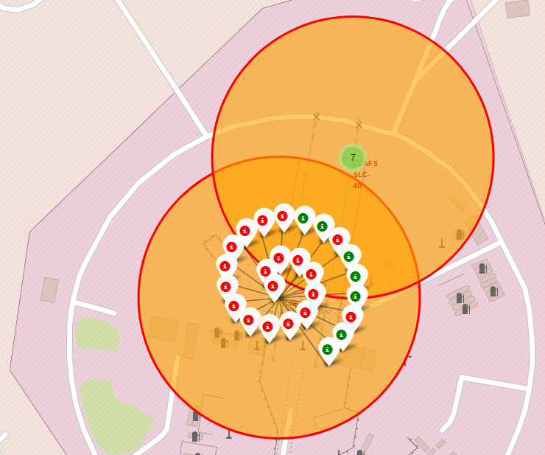
Successful and failed launches per site
A map showing the successful and failed launches at CCAFS LC-40. Green markers indicate success, red markers indicate failure.

Slide 38
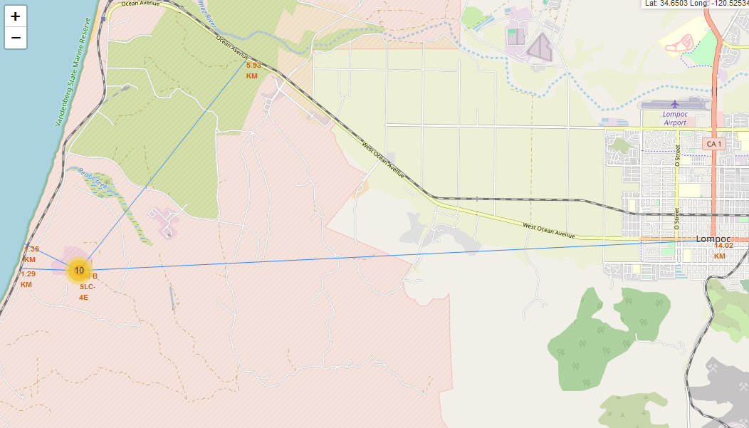
Proximity of launch site to features
Proximity of VAFB SLC-4E to its nearest railway, coastline, highway and city, with distances marked. Note the proximity to the coast/railway, and further distance from the highway and city.

Slide 39

Section 4

Slide 40
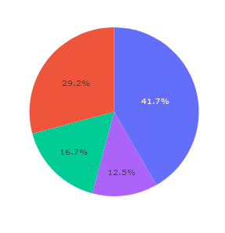
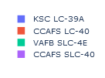
Launch Site Success Rate Per Site
As we can see, KSC LC-39A has the highest overall number of successful launches, and VAFB SLC-4E has the smallest.

Slide 41

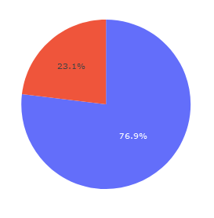

Highest Launch Site Success Ratio
We can see that KSC LC-39A also has the overall highest success rate, which invites further analysis on what makes this site the most successful in both metrics.

Slide 42
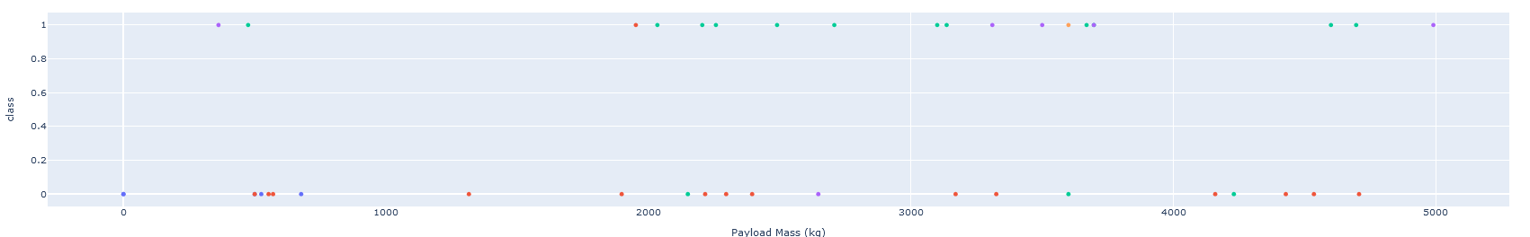
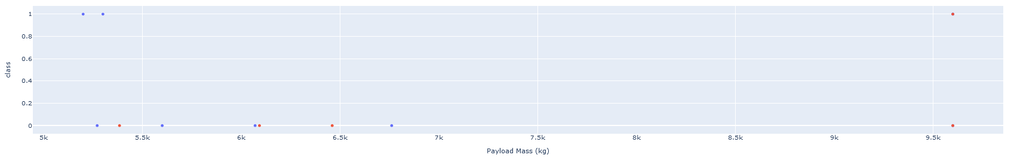
Comparison of Payload Ranges vs. Launch Outcomes
A comparison of payload ranges between 0-5000kg and 5000-10000kg across all launch sites. Larger payloads appear to have a higher rate of failure.

Slide 43

Section 5

Slide 44
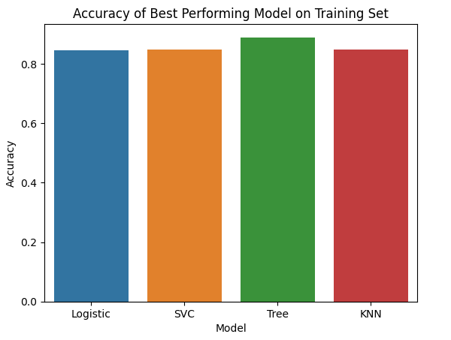
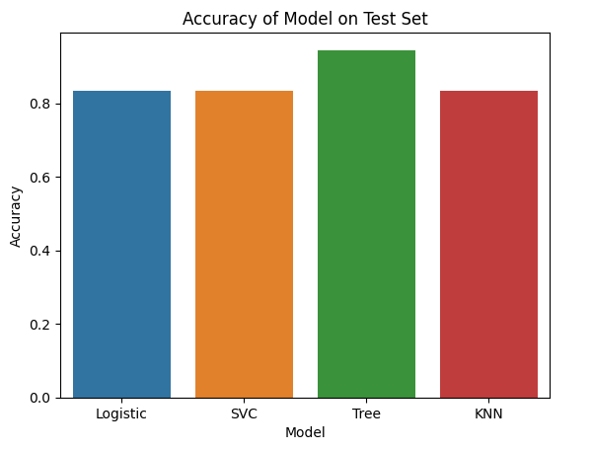
Classification Accuracy
The logistic, SVC and KNN models all had comparable accuracies. Decision Tree classifier performed the best, with 88.9% accuracy on the training set and 94.4% accuracy on the test set.

Slide 45
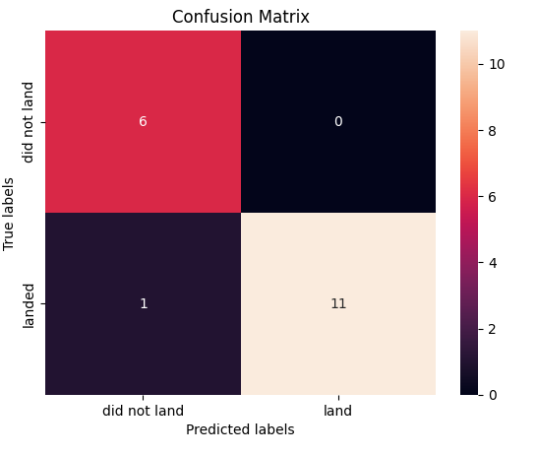
Confusion Matrix
The confusion matrix of the decision tree classifier on the test set. All failure outcomes were correctly classified, and only one false negative was assigned.

Slide 46
Conclusions
KSC LC-39A has been shown to be the best launch site in terms of landing outcomes, as it has both the highest number of successful launches as well as the highest ratio of success to failure.
Lower mass payload launches appear to incur less risk.
The overall success rate of launches has a clear increase over time, likely due to technological improvements and learning from past errors.
Decision Tree Classification provided the best accuracy on both the training and test sets, making it a good candidate for predictive analysis of future launches.

Slide 47
Appendix
All code and generated csv files can be located at https://github.com/liam-stuart/Applied-Data-Science-Capstone/tree/main
The Folium maps will not work there, hence the alternative link provided in this PowerPoint.

Slide 48


